Slide 1
LECTURE 7: SUPPLY
ECO101: Introduction to microeconomics
Fall 2020
BRAC University

Slide 2
SUPPLY SCHEDULE AND SUPPLY CURVE
A supply schedule is a table showing how much of a product firms(producers) will supply at different prices.
The supply curve is a graph illustrating how much of a given product firms(producers) would be willing to sell at different prices.

Slide 3
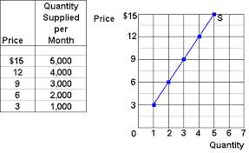
SUPPLY SCHEDULE AND SUPPLY CURVE
Supply schedule Supply curve

Slide 4
SUPPLY VS QUANTITY SUPPLIED
Supply is not the same as Quantity supplied.
Supply refers to the curve, and quantity supplied refers to a specific point on the curve.

Slide 5

THE LAW OF SUPPLY
The law of supply states that there is a positive relationship between price and quantity of a good supplied.
This means that supply curves typically have a positive slope.

Slide 6
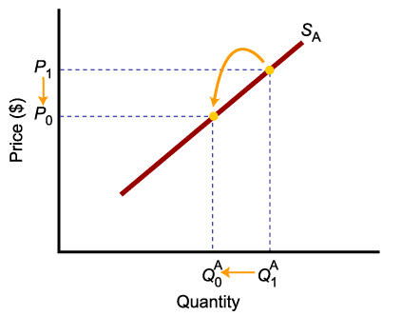
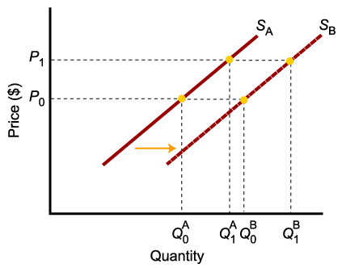
MOVEMENT ALONG THE CURVE VS. SHIFT IN THE SUPPLY CURVE
Change in price of a good or service
leads to a change in quantity supplied (Movement along the curve).
Change in costs, input prices, technology, or prices of related goods and services leads to a change in supply
(Shift of curve).

Slide 7
DETERMINANTS OF SUPPLY
The price of the good or service.
The cost of producing the good, which in turn depends on:
Price of Inputs (labor, capital, and land),
Technology
Expectations
Government Policy (Taxes, Subsidies and Regulations)
Competition

Slide 8
PRICE
A change in price causes a movement along the supply curve

Slide 9
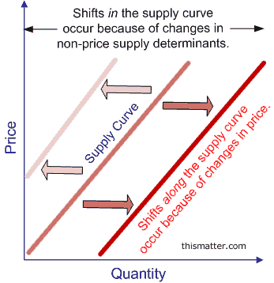
SHIFT FACTORS OF SUPPLY
A right shift means an increase in Supply
A left shift means a decrease in Supply

Slide 10
SHIFT FACTORS OF SUPPLY
Price of Inputs (labor, capital, and land)
If input costs rise with no change in output, profits will decline, and a firm has less incentive to supply and vice-versa.

Slide 11
SHIFT FACTORS OF SUPPLY
Technology
New technology can reduce the costs of production, leading to an increase in supply

Slide 12
SHIFT FACTORS OF SUPPLY
Expectations
Supplier expectations are an important factor in the production decision.
If a supplier expects the price of the good to rise at some time in the future, it may store some of today’s supply to sell it later and reap higher profits, decreasing supply now and increasing it later.

Slide 13
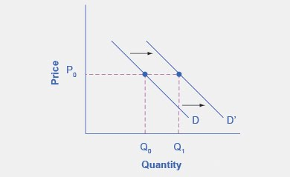
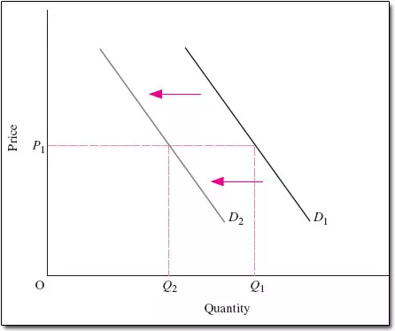
INCOME
Normal Goods – For normal goods demand increases with an increase in income or vice-versa.
Higher income => higher demand
Lower income => lower demand

Slide 14
INCOME
Inferior Goods –For inferior goods demand decreases with an increase in income or vice-versa.
Lower income => higher demand
Higher income => lower demand

Slide 15
PRICES OF RELATED GOODS
Changes in the prices of related goods can increase or decrease demand.
Substitute Goods: Two goods are substitute goods if an increase in price of one good causes an increase in the demand for another good.
Complementary Goods: Two goods are complementary goods if an increase in price of one good causes a decrease in the demand for another good.

Slide 16
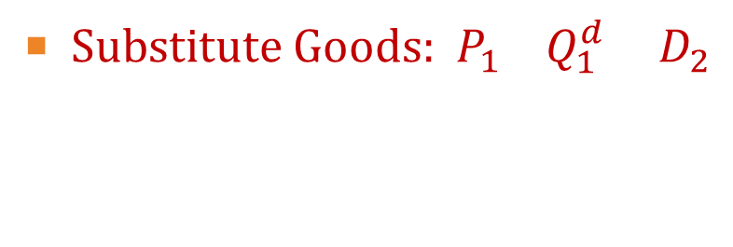
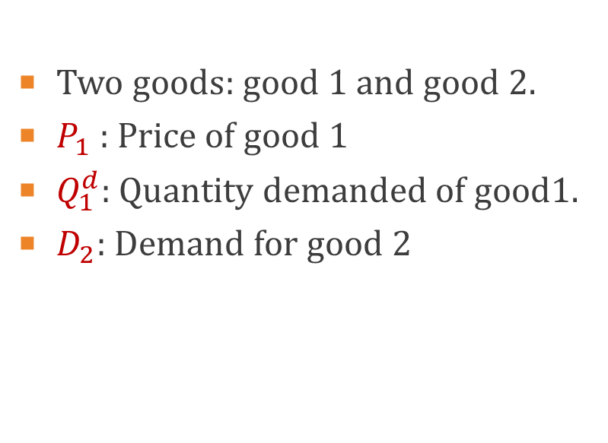
PRICES OF RELATED GOODS

Slide 17
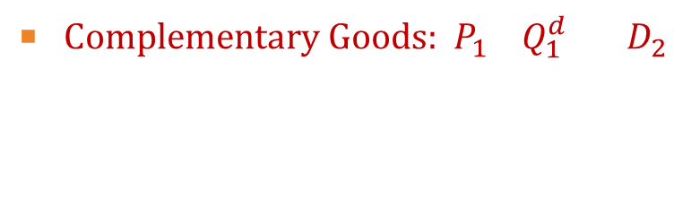

PRICES OF RELATED GOODS

Slide 18
TASTES AND PREFERENCES
Demand curve can shifts due to changes in tastes over time.
Favorable change in taste => higher demand
Unfavorable change in taste => lower demand

Slide 19
EXPECTATIONS ABOUT FUTURE PRICES AND MARKET CONDITIONS
Demand curve can shifts due to changes in expectations.
For example, if you expect the price of computers to fall soon, you may put off buying one until later.
Positive expectation=> higher demand
Negative expectation=> lower demand

Slide 20
POPULATION/ NO OF CONSUMERS
Demand curve can shifts due to changes in population/ no of consumers.
Increase in population/no of consumers => higher demand
decrease in population/no of consumers => lower demand

